Slide 1
CAR Calibration Meeting CAR Review
AP Team
Funny Li, Ravi V, Matthew Kim, J.Y. Lee and Kila Yang
February 2014

Slide 2
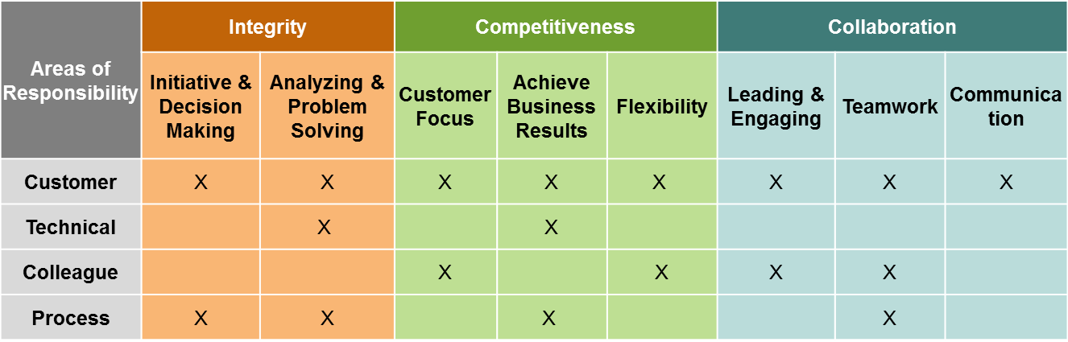
CAR Champion Critical Behaviors for Success
Alignment with Critical Behaviors for Success and UL Values
CAR Champion, Areas of Responsibility:
C – Customer; T – Technical; L – Colleague; P – Process.
Notes:
EIGHT (8) CBS attributes :-
(CAR Champion, Areas of Responsibility: C – Customer; T – Technical; L – Colleague; P – Process)

Slide 3
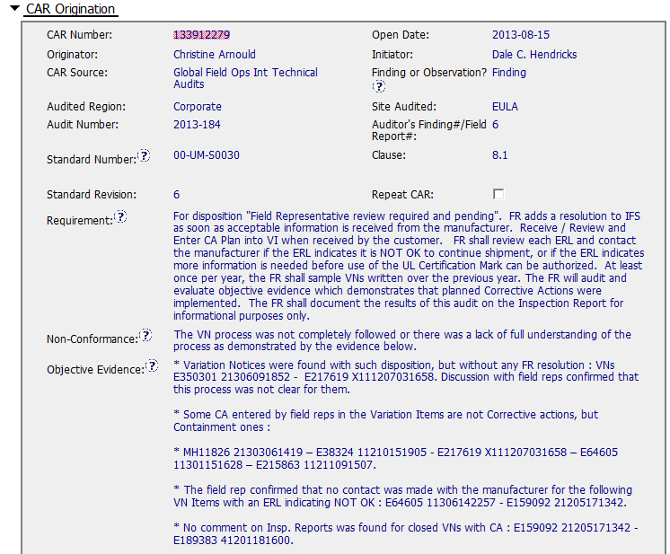
CAR# 133912279
3
2
1
4
1
2
3
4

Slide 4
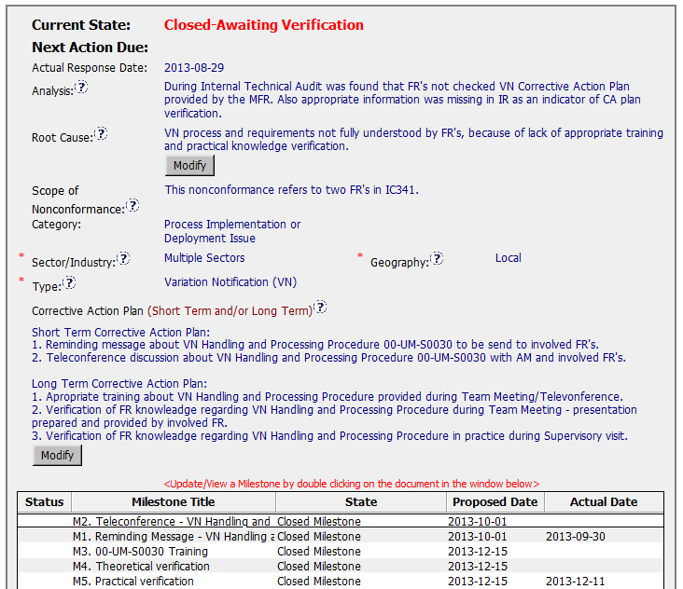
CAR# 133912279 (Analysis)
No stakeholders involved in this Analysis, no detail analysis conducted for the cited above 4 non-conformance
1. Re-statement of non-conformance
2. Based on FAQ19 of CAR Process Website, the true root cause has not yet been found. (http://corporate.ul.com/departments/snk5212/QE/FAQ.cfm)
9 VNs involved, no analysis conducted to determine its spread.
No containment actions taken for this Finding CAR
No actions taken for these impacted VNs.

Slide 5
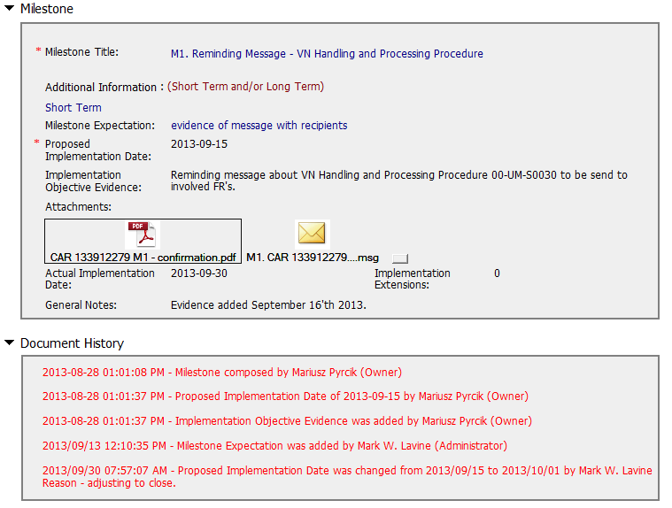
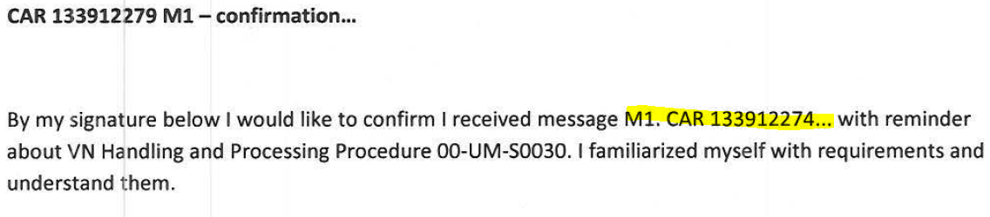
CAR# 133912279 (Milestone 1)
[PDF file content] Wrong CAR No. description

Slide 6
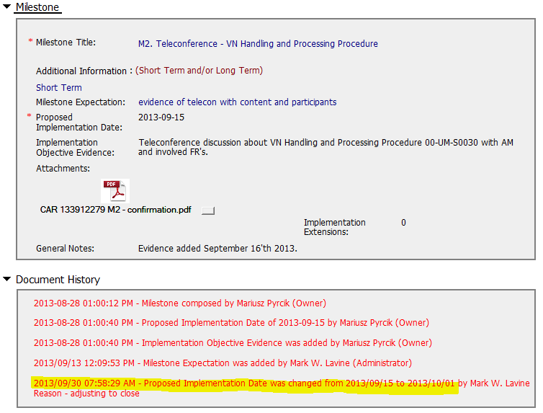
CAR# 133912279 (Milestone 2)

Slide 7
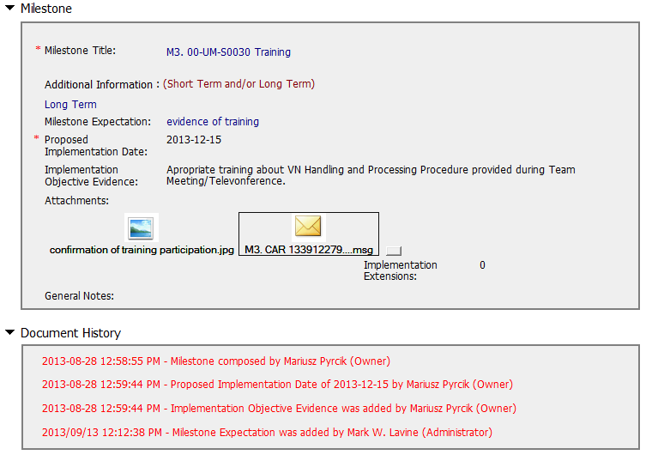
CAR# 133912279 (Milestone 3)

Slide 8
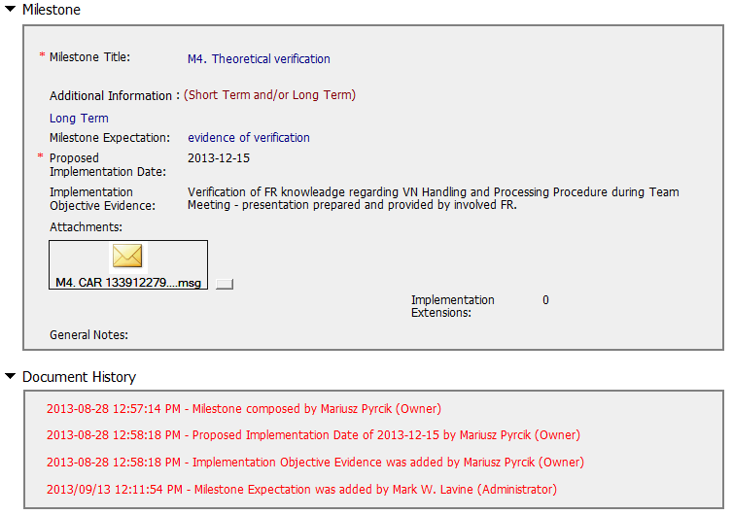
CAR# 133912279 (Milestone 4)

Slide 9
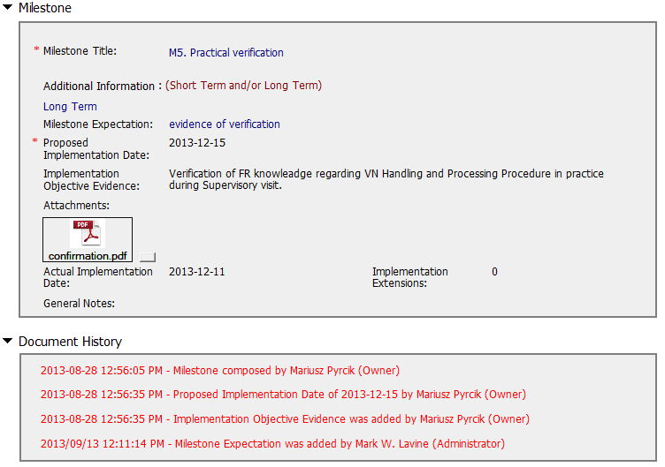
CAR# 133912279 (Milestone 5)

Slide 10
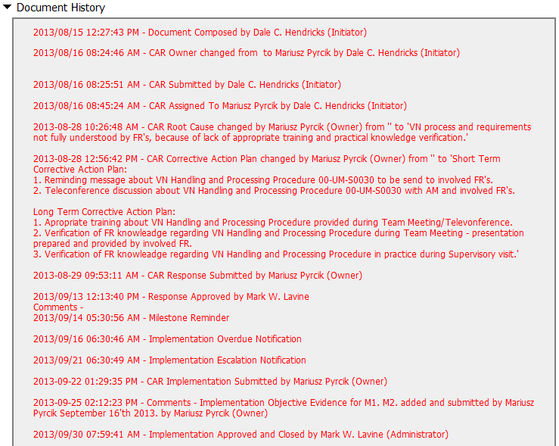
CAR# 133912279 (Document History)

Slide 11
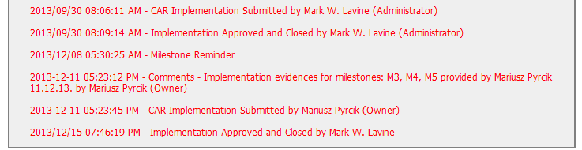
CAR# 133912279 (Document History)

Slide 12
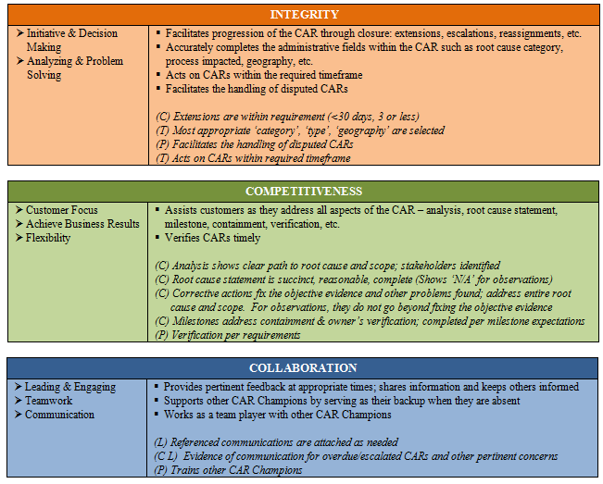
CAR# 133912279 (CAR Champion CBS)

Slide 13
Corrective Action Review for Calibration Meeting (March, 2014)
V 1.0

Slide 14
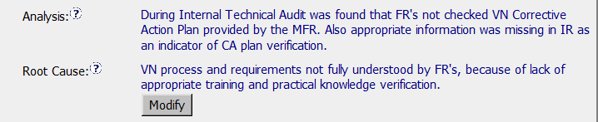
CAR 133912279
There should be a stronger analysis path, possibly the 5 whys, including stakeholders identified.
No evidence to support the nonconformance limited to instances cited.
Based on the analysis, difficult to see how the root cause was discovered.

Slide 15
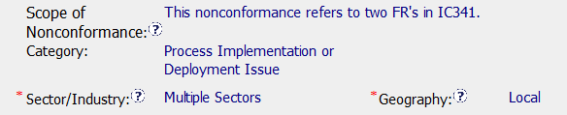
CAR 133912279
As a Finding, there is no evidence that there was additional research done to insure that this non-compliance is limited to these two FR’s
If the root cause is a training issue is the category Process Implementation or Deployment the correct category?
If this non-compliance spans over multiple sectors, and without additional research on how wide spread this concern maybe is Geography: Local appropriate?

Slide 16
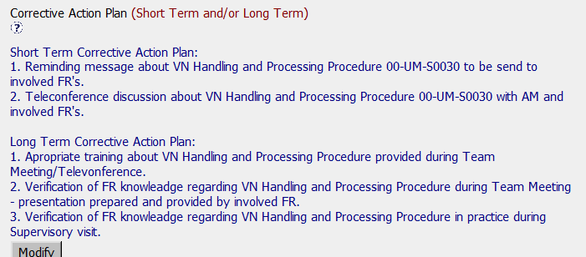
CAR 133912279
Based on the corrective action given the plan for retraining is good
Was this training missed? When are the team members supposed to be trained on this?

Slide 17
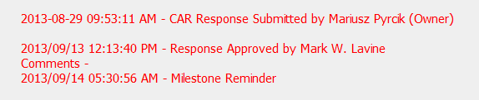
CAR 133912279
Delay in response time for CAR champion from response submitted 8/29 to approval 9/13 – over 9 day preferred time frame

Slide 18
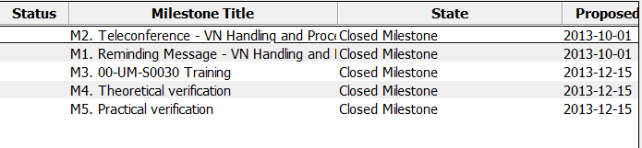
CAR 133912279
Good Implementation on all milestones
Good collaboration between CAR champion and CAR owner

